Slide 1
-6
-5
-4
-3
-2
-1
MyList =
“Hello”
“Peepo”
25
None
56
10
True
1
4
0
3
2
0
1
0
1
2
3
4
5
0:2

Slide 2
Initial list
Lst =
False
56
56
True
1
35
565
65
45
56
34
21
103
106
Lst.append(103)
Lst.append(103+3) # = 106
Lst.append(10>30) # = False
Lst.extend([56,56,True])

Slide 3

Initial list
Lst =
45
78
98
68
Lst =
45
78
“imposter”
Lst.insert(2, “imposter”)
Lst.remove(“imposter”)
Lst.pop(2)
98
68
Lst =
45
78
98
68
Item_popped

Slide 4
Lst =
45
78
98
68
Lst =
Lst.sort()
45
68
78
98
Lst.sort(reverse = True)
98
78
68
45
Lst =

Slide 5
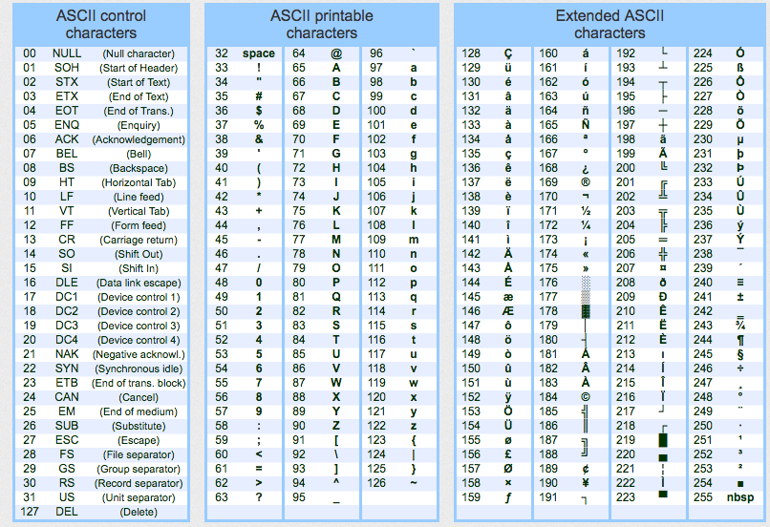
“Pi”
“Peepo”
Lst =
“@#lol!”
Lst.sort() # how will it sort the string? Alphabetically? Some has symbols too how will it manage that?
String are stores as ASCII or unicode values in code. They are numbers.so while sorting it check each character ascii instead of character.
Python compares ascii of first characters of each string. If they match it check second unless one is greater than other.
So while sorting. …
P = 80 and @ = 64 so “Pi” > “@#lol!”
Now for index 0 and 2
P = 80 and P = 80 # it will check next character
i = 105 and e = 101 so “Pi”> “Peepo” > 45
Lst =
“@#lol”
“Peepo”
“Pi”

